Slide 1
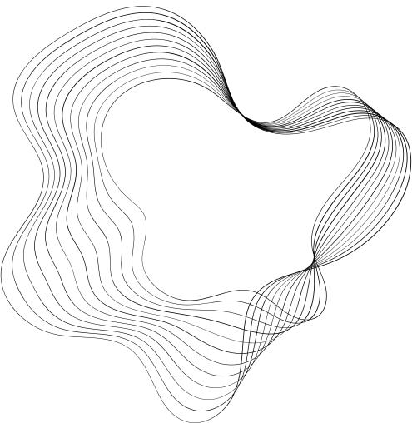

PYTHON PROJECT
WikiPy

Slide 2
TEAM MEMBERS
KRISHNA BUDHATHOKI
KUNAL JAYSWAL
UZWAL MAINALI

Slide 3

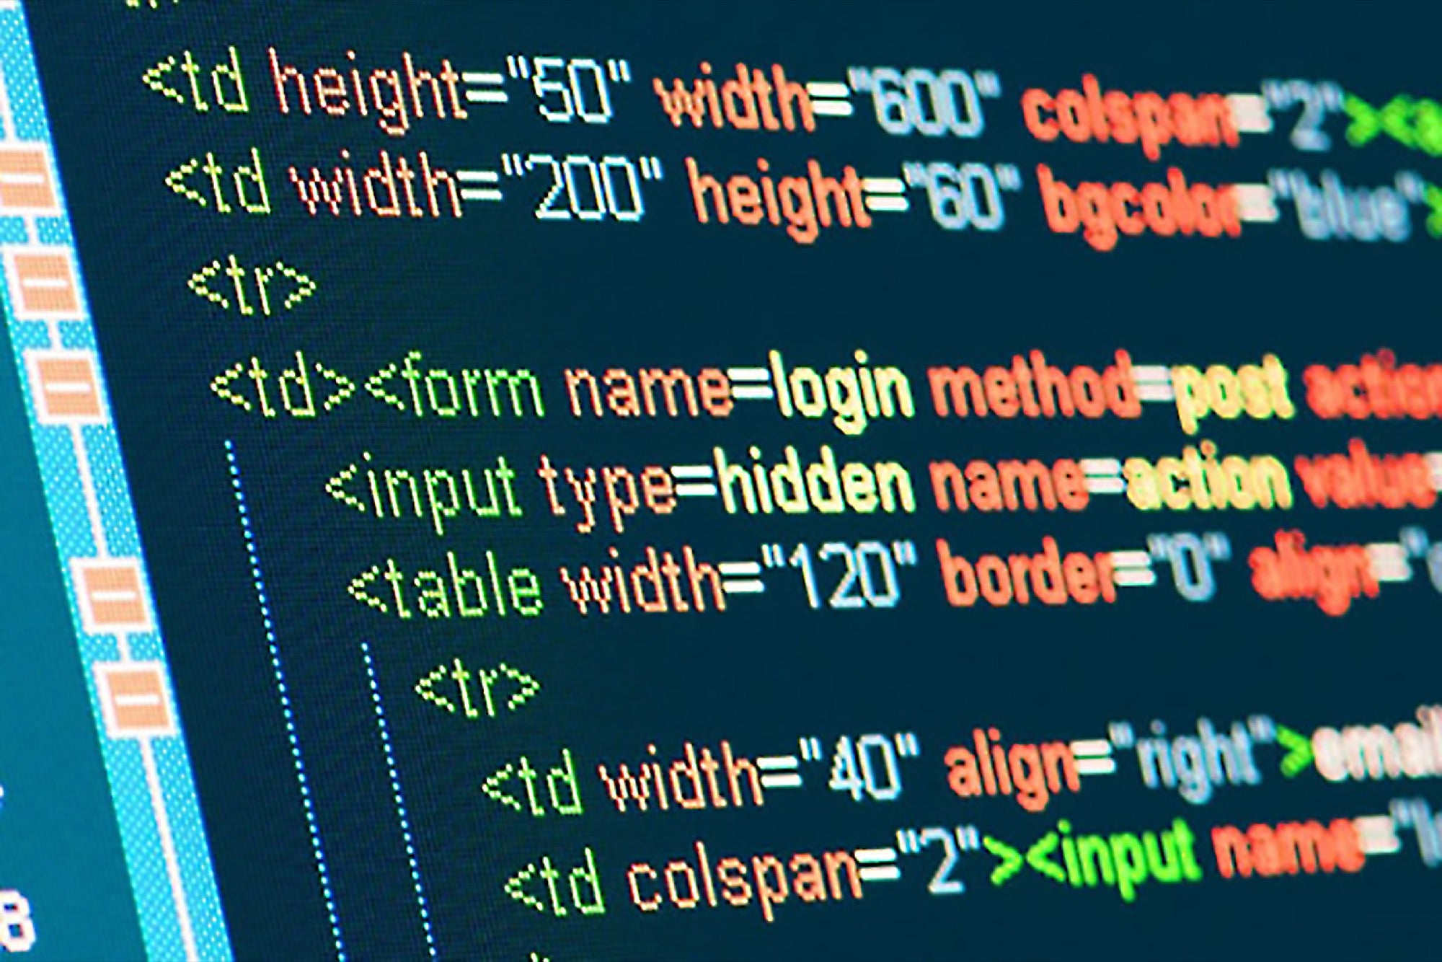

ABSTRACT
Built with Python Django web framework
Allows users to create and view pages similar to Wikipedia
Two main components: views.py for handling user requests and rendering templates, and util.py for processing data and interacting with Markdown files
Provides a simple way for users to share knowledge
Utilizes Django and Python for a robust and maintainable codebase

Slide 4
INTRODUCTION
Our project aims to create a Wikipedia-like website using Python programming language.
The website will allow users to search for information, provide random articles and many more.
User can create and edit article related to different places to visit in different countries
Article pages: Each article will have its own page. We can expand content by adding articles in different fields
It uses Django framework for the backend and HTML and CSS for the front end.
Instead of database we have used Markdown

Slide 5
METHODOLOGY
User Input: Here the data input is given by the user and the individual using it and others get to learn from it.
Views and Templates: the role of views.py and templates in your application, and how they help to communicate in different level.
Markdown Storage: Explain how your application stores user-generated content in Markdown format, and how this allows for easy editing and version control.
Retrieval and Rendering: Discuss how the application retrieves and renders Markdown files as HTML web pages, and how this provides a rich and interactive user experience.
Editing and Updating: Describe how users can edit and update existing pages using web forms, and how these changes are stored and versioned in the Markdown files.

Slide 6
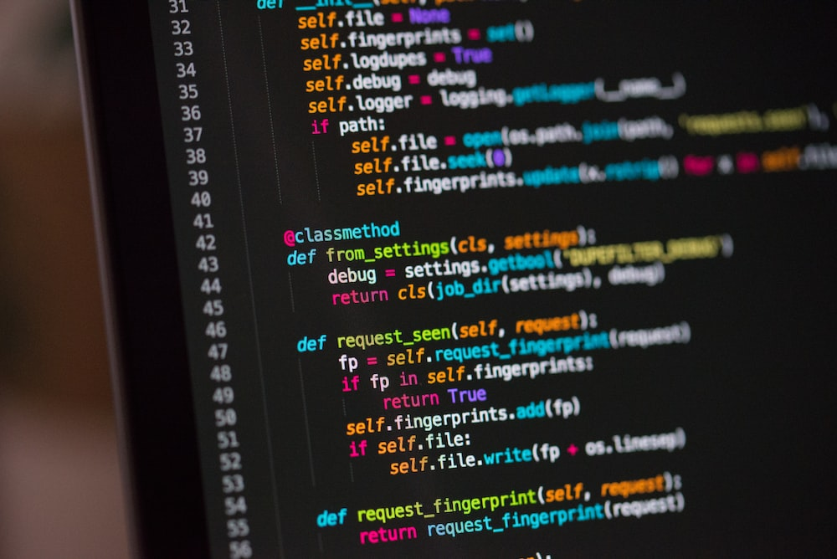
TECHNOLOGY STACKS
Python Django: We used python as the primary programming language for the project.
HTML/CSS: We used web development technologies to create the user interface and design the webpage.
Markdown: We used Markdown files to create content for our website and then converted them to HTML using a library or tool.

Slide 7
ISSUES FACED
We had technical difficulties setting up a development environment, deciding which database to use, and integrating different project components.
Creating a Wikipedia-like project involves collaborative work, as multiple students may contribute to the same article. This can lead to conflicts in the writing style, formatting, and content to be made in the program.
We had to use proper guidance, support, and resources to overcome these challenges and ensure the project’s success.

Slide 8

DEVLOPMENT APPROACH
Agile Approach
This approach involves an iterative and incremental development process where the project is developed in small increments. Each increment is designed, developed, tested, and released, and the process is repeated until the final product is delivered.
The agile approach allows for flexibility and adaptability to changes in requirements and user feedback.
We had to go through several iteration process to make our project successful.

Slide 9
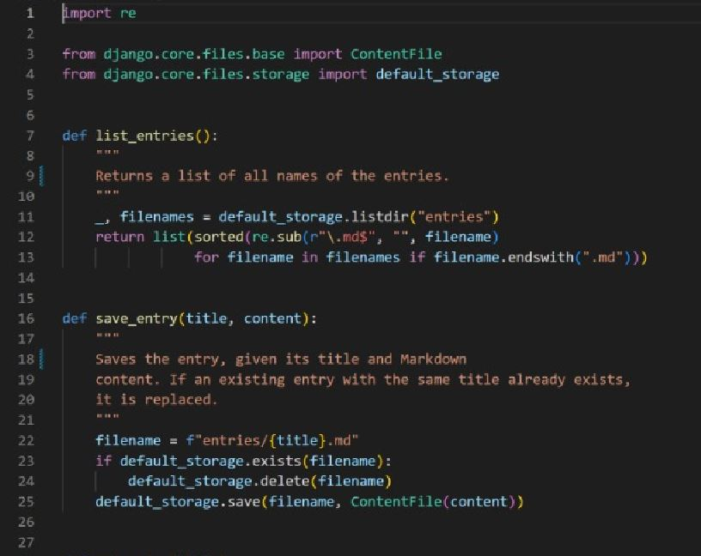
TECHNICAL OVERVIEW
FUNCTION TO SAVE AND LIST ENTRIES
We had to list the entries.
Save the entries.

Slide 10
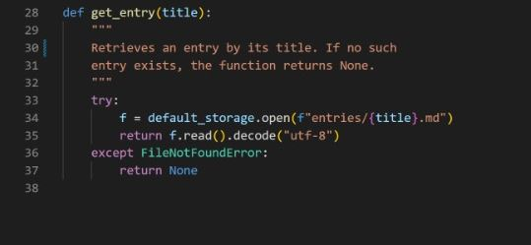
TECHNICAL OVERVIEW
GET ENTRY FUNCTION
We had to add a get entries function to get the entries that we have entered.

Slide 11
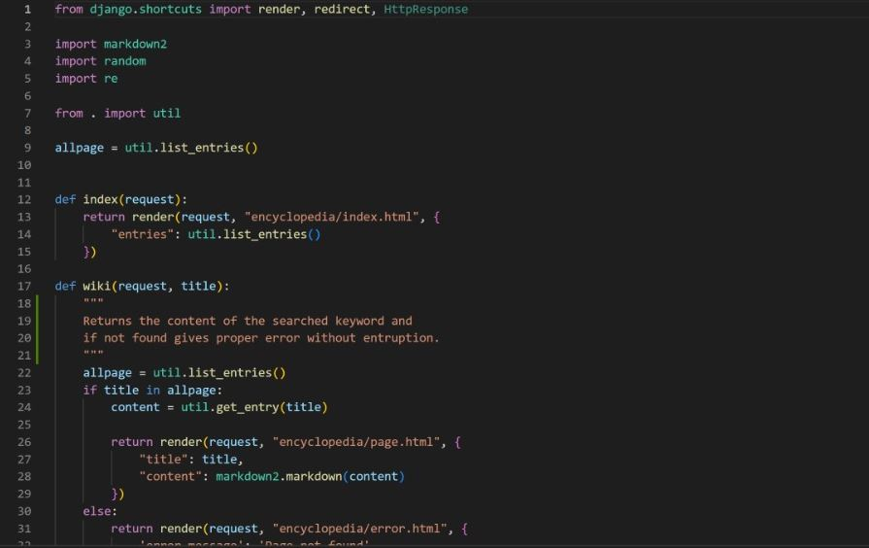
TECHNICAL OVERVIEW
MARKDOWN FILE
In this section we had to make a indexing.
This was our most important part as it would save the markdown file.

Slide 12
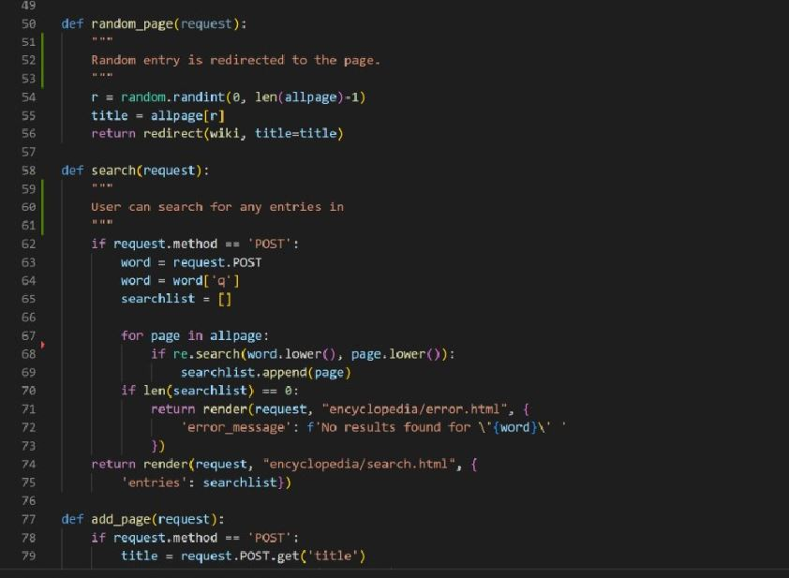
TECHNICAL OVERVIEW
RANDOM AND SEARCH ENTRIES
This part was used for getting a search option and random page opener

Slide 13
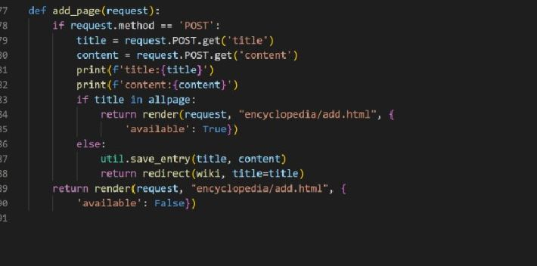
TECHNICAL OVERVIEW
ADD PAGE
This function is used to add a page.

Slide 14
DEMONSTRATION OF PROJECT

Slide 15
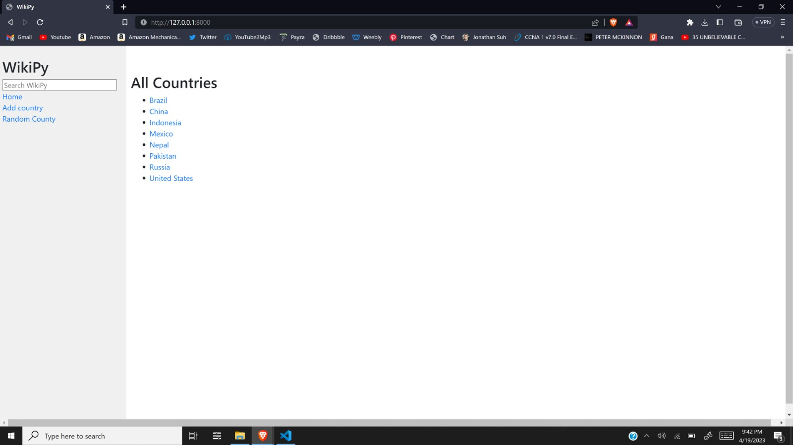
SCREENSHOT OF WEBPAGE

Slide 16
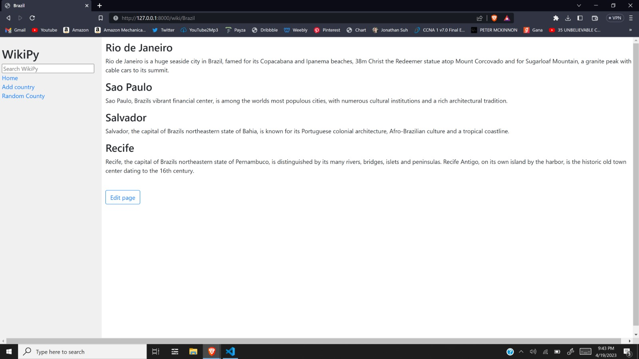
SCREENSHOT OF WEBPAGE

Slide 17
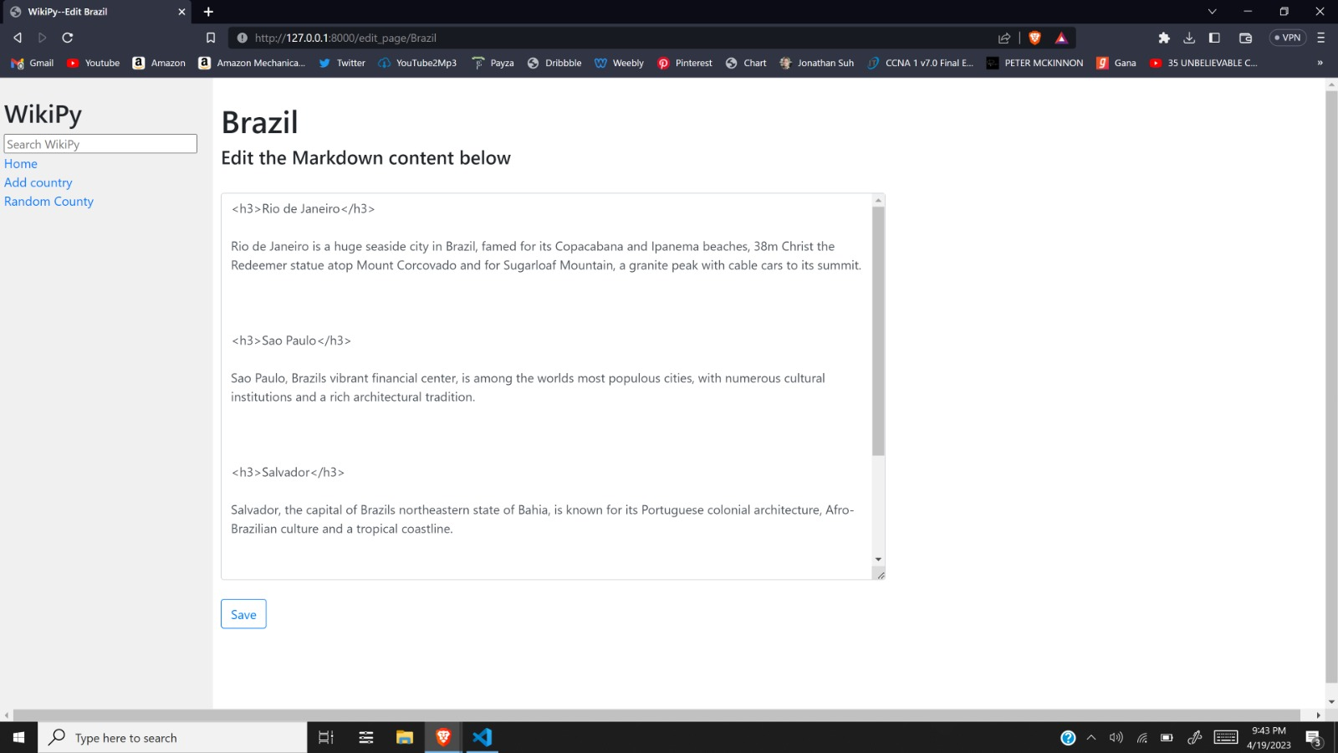
SCREENSHOT OF WEBPAGE

Slide 18
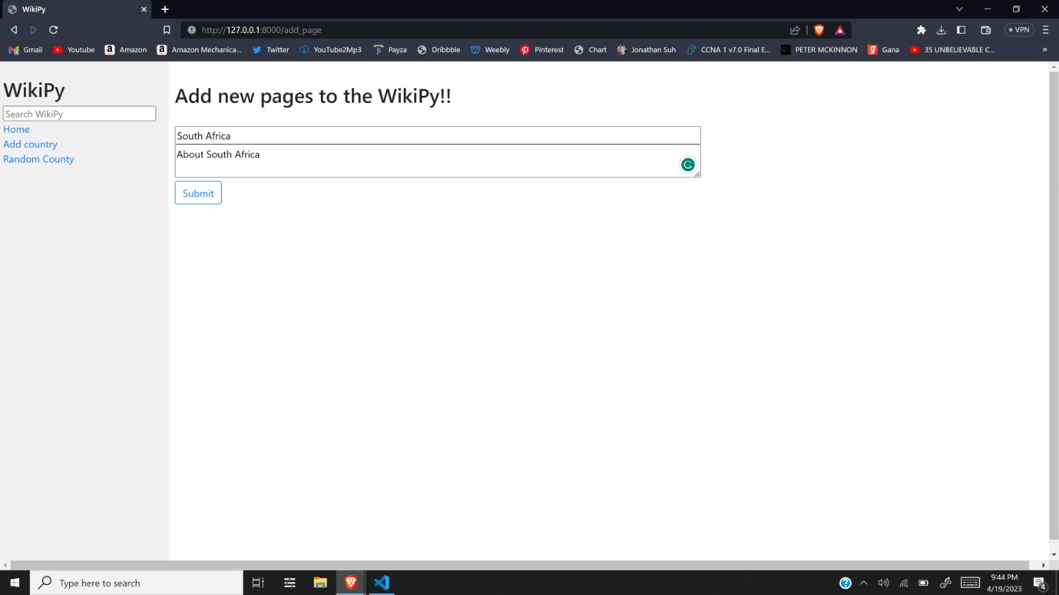
SCREENSHOT OF WEBPAGE

Slide 19
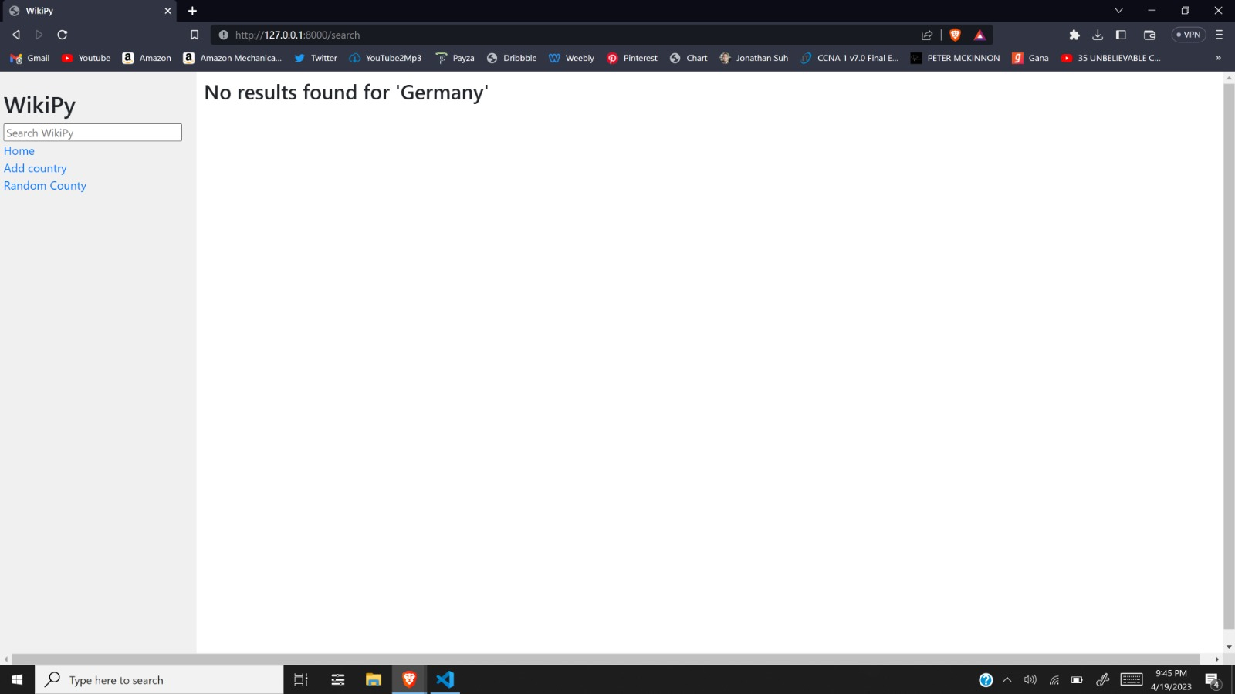
SCREENSHOT OF WEBPAGE

Slide 20
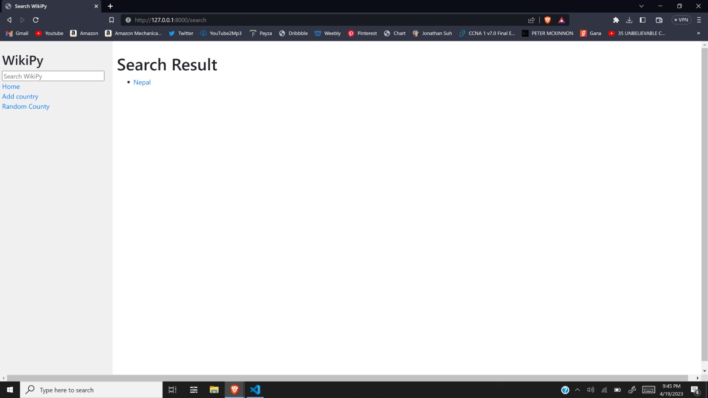
SCREENSHOT OF WEBPAGE

Slide 21
CONCLUSION
Our WikiPy project will provide users with a platform to access and contribute to information on a variety of topics.
We aim to create a user-friendly website with a simple interface that is easy to navigate.
With the use of modern web development technologies, we hope to deliver an innovative and useful tool to the online community.

Slide 22
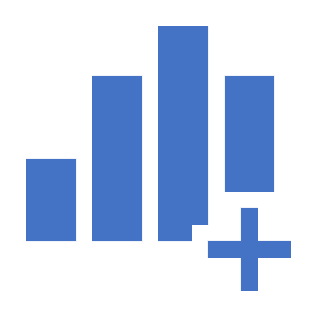
FUTURE WORKS
We want to make a login system to see who updated the data.
We would like to pay more attention to our design as it is a crucial part of a project.
We would like to add images and a related information section for users to navigate more information.
We would like to add third-party options where we can use reliable information to compare with ours for authenticity.

Slide 23
https://www.geeksforgeeks.org/django-tutorial/
https://www.w3schools.com/html/html_css.asp
https://www.digitalocean.com/community/tutorials/how-to-use-python-markdown-to-convert-markdown-text-to-html
https://www.geeksforgeeks.org/introduction-to-markdown/
https://www.tutorialspoint.com/grav/grav_markdown_syntax.htm
REFERENCES

Slide 24
ANY QUESTIONS ?

Slide 25
THANK YOU

